Slide 1
Planning tool
Employee time management
Developer: Liudmila Draugelė

Slide 2
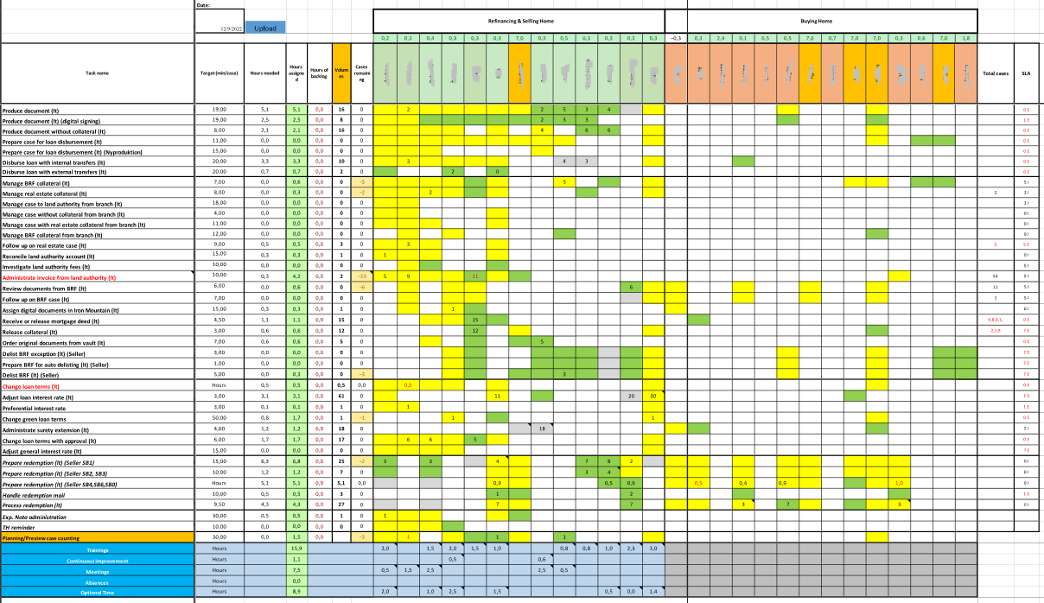

Slide 3
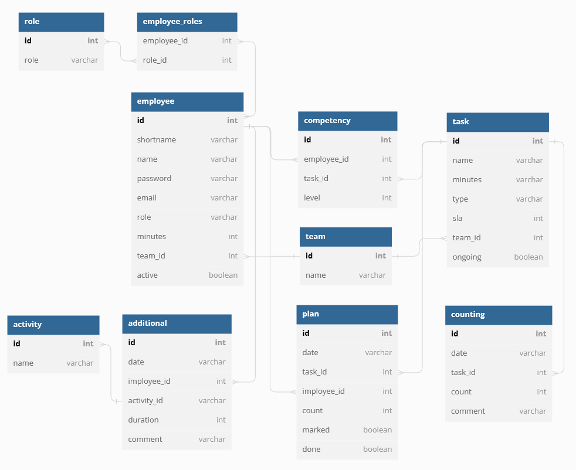

Slide 4
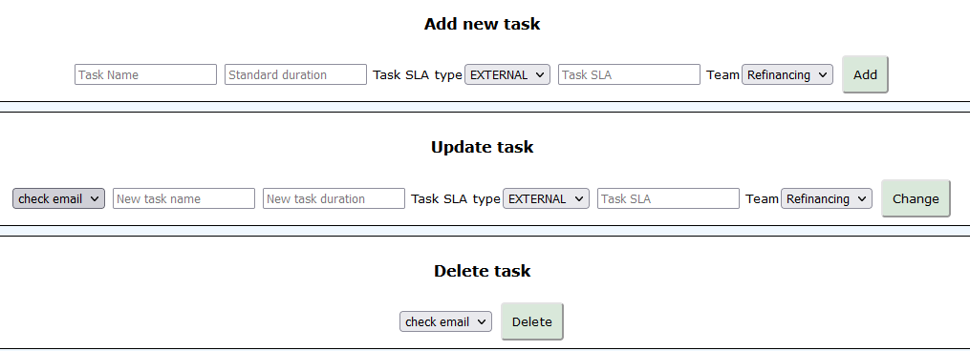
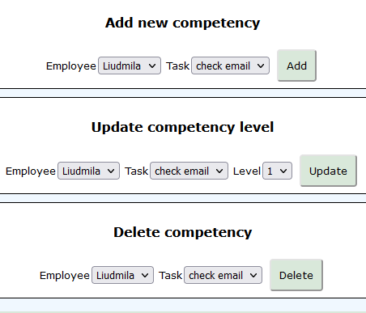
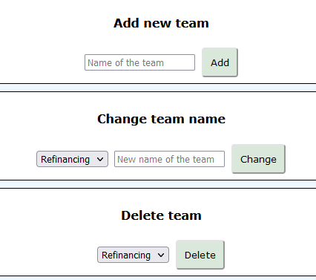
Main functions
Create, read, update and delete following entities:
Employees
Tasks
Teams
Competencies
Create, read and update following entities:
Additional time for each employee
Task counting for the day
Planned tasks for each employee

Slide 5
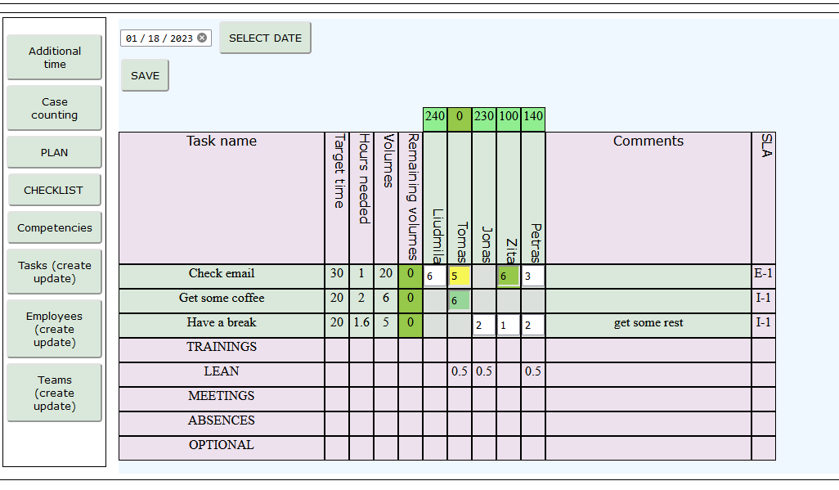

Slide 6
Ideas for future improvements
Make buttons and advanced functions visible only to those, who have superior role
Implement employee active/disabled status. Deny disabled employees from logging in
Implement task ongoing/retired status
Make checklist for the employee to track if tasks are done
Make color variation for the team leader to track how the day is going according to every employee’s checklist.
And so on…

Slide 7
Any questions?
Let’s head to the actual application ☺

